Slide 1
Short Line Railroad Improvement Fund Webinar
July 8, 2020

Slide 2
WELCOME!
KDOT Team Members
John Maddox
Michelle Needham
Cory Davis
Eddie Dawson

Slide 3
History of the Short Line Rail Improvement Fund
Introduced in the 2020 Ike Legislation
The program is for the purpose of facilitating maintenance, rail relay and the rehabilitation of track, bridge, industrial leads and sidings on Class II or III (short line) railroads in Kansas.

Slide 4
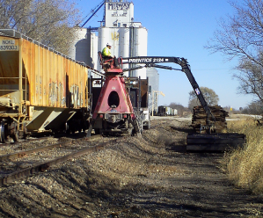
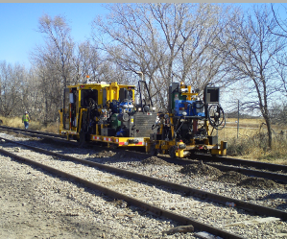
Funding
Program funding is $5 million per year for three consecutive years and will be available:
July 1, 2020
July 1, 2021
July 1, 2022

Slide 5
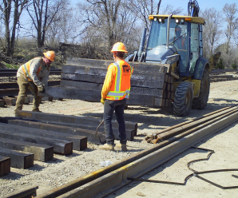
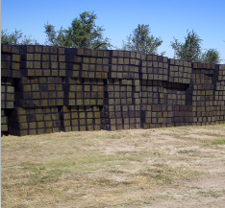
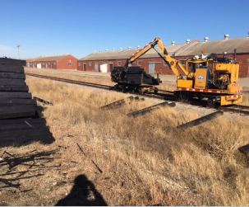
Qualified Entities
Qualified entities include any Class II or Class III railroad, as defined in 49 C.F.R., part 1201.1, holding a certificate of public convenience from the Surface Transportation Board or any owner or lessee located on or adjacent to a Class II or Class III (short line) railroad in the state of Kansas.

Slide 6
Requirements
30% of total project costs is required in the form of matching funds from the qualified entity.
A reimbursable grant of 70% of total project costs will be applied to approved projects.
The qualified entity shall demonstrate that it is financially sound and capable of fulfilling all obligations associated with the Short Line Rail Improvement Fund and requirements created by the agreement to perform the project.

Slide 7
Guidelines
Must be completed within 12 calendar months from the project Notice to Proceed date
For Kansas shippers, a letter of support from the serving railroad acknowledging project coordination and confirmation of regularly scheduled rail service and rail car supply with the qualified entity is required.
Following project completion, the qualified entity shall maintain, at a minimum, existing FRA track classification speeds.

Slide 8
Guidelines Continued
The qualified entity shall demonstrate that it is financially sound and capable of fulfilling all obligations associated with the Short Line Rail Improvement Fund and requirements created by the agreement to perform the project.
Term of the agreement is 10 years from the project Notice of Acceptance date and the rehabilitated line (project) will not be abandoned for 10 years following the project Notice of Acceptance date.
If a project includes rail replacement on short line railroad mainline track, a minimum of 112-pound rail is required.
Project shall meet all Federal Railroad Administration (FRA) and American Railway Engineering and Maintenance-of-Way Association (AREMA) guidelines.
A final project inspection will be conducted by a third-party FRA certified track inspector

Slide 9
Project Selection Criteris
Three Categories:
Maintenance
Spurs/Sidings
Mainline Track Rehabilitation

Slide 10
Project Selection Criteria Continued
Maintenance
Long term impact on the rail segment – How does this maintenance project support the long-term operation of this rail segment
Short term impacts – Identify the immediate short-term impacts or benefits of the project
Safety benefits – Does the project have a direct safety benefit
Illustrate maintenance priority – Identify how maintenance project was prioritized over other maintenance needs

Slide 11
Project Selection Criteria Continued
Spur/Siding
Economic Benefit/Competitiveness/New business – Describe the economic benefit of this project related to new or existing companies that will benefit from the project.
Other investments – Have any other investments been made in relation to this project that would support or tie into additional investments requested through this program
Local Support/Project Partners – Identify statements of local support and any project partners that will be investing in this project.
Goods movement/Logistic improvements – Explain how this project will aid in more efficient goods movement or aid in improving transportation logistics.
Job Creation/Market served – Define any job creation associated with this project and identify the markets that this project will serve.

Slide 12
Project Selection Criteria Continued
Major Rehab
Truck Traffic Reduction – Identify how this project will reduce truck traffic on the highway network.
Efficiency Improvements/Reliability – Describe the impact of the project as it relates to more efficient operations and increased reliability to customers.
Viability of railroad – Describe how this project will support the long-term viability of the railroad.
Safety – How will this project enhance the safety of rail operations?
The Benefit-Cost Analysis tool could be used to further assist the project selection committee.

Slide 13
SLRIF versus RSIF - Differences
SLRIF
30% Match
70% Grant
Qualified Applicants – short line railroads and shippers located on short line railroads
Maintenance Projects
SRIF
Minimum 40% match
Maximum 60% grant
Benefit-Cost Analysis
Statutory Requirement – Benefit-Cost Ration of 1.0> to do projects
Can also be used for the purchase of railcars and locomotives
Qualified Applicants – short line railroads, shippers, local units of government
No maintenance projects

Slide 14
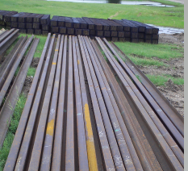
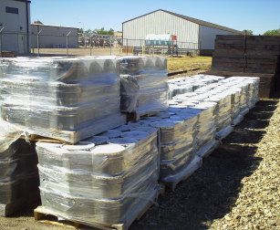
Calls for Applications
Qualified entities will submit a Short Line Rail Improvement Fund project application to the Kansas Department of Transportation, Freight and Rail Unit. Please contact John Maddox at john.maddox@ks.gov
Calls for applications with occur the first week of July in 2020, 2021 and 2022
SLRIF Application and Programs Guidelines can be found on KDOT’s Freight and Rail Webpage http://www.ksdot.org/burRail/Rail/default.asp

Slide 15
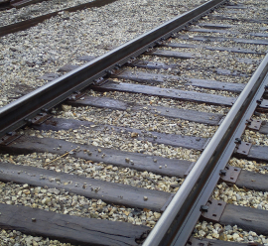
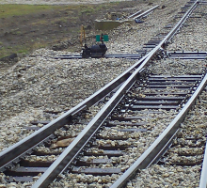
Questions / Feedback
Thank You!

