Slide 1
Federal Fund Exchange
Program Modifications beginning with Federal Fiscal Year 2018

Slide 2
Agenda
What modifications are being made?
Why are the modifications being made?
What happens next?
Review of required forms
Question and Answers

Slide 3
Before we begin…
It is important to note that KDOT voluntarily provides these funds, whether LPAs choose federal or state dollars. There is no statutory requirement that the agency shares the federal funds or offers an opportunity for LPAs to exchange them for state money. However, KDOT is committed to maximizing opportunities for transportation improvements across the state, so the agency provides these funds to assist local governments in meeting their communities’ needs.

Slide 4
What Modifications are being made?
After re-evaluating the FFE program as originally established in Federal Fiscal Year (FFY) 2011, KDOT has determined the need to adjust our guidelines. Effective with Federal Fiscal Year 2018 (October 1, 2017):
Banking of Federal or State funds in the program will no longer be permitted. All such funds available to the Local Public Authority (LPA) must be used or requested for reimbursement by September 15 of the FFY of the distribution. Any funds remaining after September 15 will be lost to the LPA to which they were made available.
Beginning with FFY 2018, the exchange rate will be temporarily reduced to $0.75 State Funds/$1.00 Federal funds. The exchange rate will be reviewed and established annually by the Secretary of Transportation.

Slide 5
Why are the Modifications being made?
Removal of Banking Option
Under the current “banking” option, the outflow of State funds has varied from $15 Million to over $60 Million in a given year. This has made predicting the outflow of State funds extremely difficult.

Slide 6
Why are the Modifications being made?
Modification of Exchange Rate
State Cost of Program at $0.90/$1.00 Exchange Rate
To use $30 Million Federal Funds
State pays $27 Million to LPA’s + $7.5 million required match = $34.5 Million
State Cost of Program at $0.75/$1.00 Exchange Rate
To use $30 Million Federal Funds
State pays $22.5 Million to LPA’s + $7.5 million required match = $30 Million
From KDOT perspective, this establishes “Break even” point at $0.75/$1.00

Slide 7
Why are the Modifications being made?
Modification of Exchange Rate
LPA Cost for Typical Project $0.90/$1.00

Slide 8
Why are the Modifications being made?
Modification of Exchange Rate
LPA Cost for Typical Project $0.75/$1.00

Slide 9
Why are the Modifications being made?
Modification of Exchange Rate
LPA Typical Project “Break even” point also about $0.75/$1.00
HOWEVER: LPA’s still retain the flexibility to do work that cannot be funded with Federal funds, like maintenance activities, or to purchase materials so that work can be performed by local crews.

Slide 10
Based on 2015 Statistics

Slide 11
What happens next?
Modification of FFE Program Guidelines and forms to be placed on KDOT BLP Webpage.
With 2018 Distribution:
Supplement to FFE Master Agreement to establish program revisions.
Updated Request to Exchange form for 2018.
Updated Request for Reimbursement form for 2018.
ALL of these items, accounting for the entire amount of funds available to the LPA, must be received by KDOT by September 15 of the Federal Fiscal year of the distribution.

Slide 12
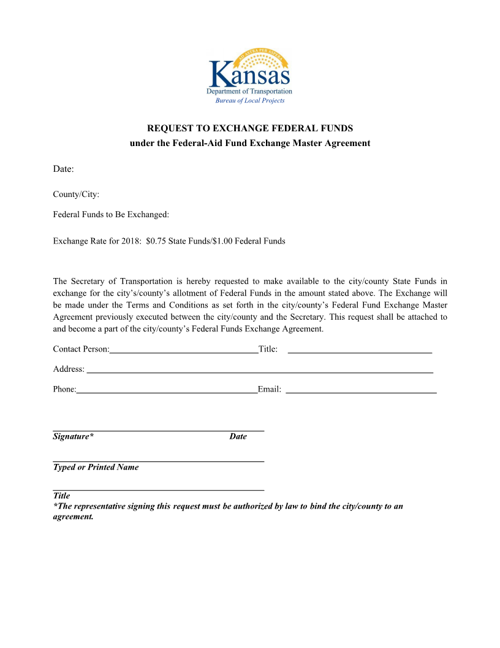
Review of required forms
Request to Exchange Form

Slide 13
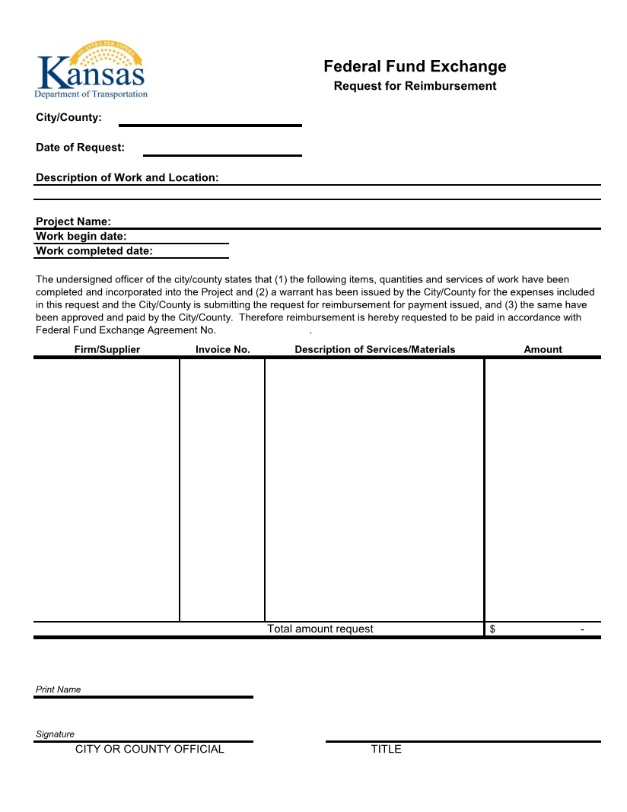
Review of required forms
Request for Reimbursement Form
Not asking for copies of invoices.

Slide 14
Questions?

Slide 15
Contact Information
Michael Stringer, P.E., Chief
Bureau of Local Projects
Michael.stringer@ks.gov
(785) 296-3861
Tod Salfrank, Assistant Chief
Bureau of Local Projects
Tod.salfrank@ks.gov
(785) 368-7396

